Slide 1
Chest X‑Ray Disease Classification using Deep Learning
Name- Sayali Lohokare Module – CS618 Date – 07/12/2025

Slide 2
MOTIVATION
Chest X‑rays are one of the most common medical imaging tests.
Subtle findings are easy to miss and radiologists have high workload.
Deep learning can help with automatic screening and decision support.

Slide 3
Dataset: ChestX‑ray14
NIH ChestX‑ray14: 112,120 frontal X‑rays, 30,805 patients.
14 thoracic disease labels, multi‑label (multiple diseases per image).
In this project: used the train‑small subset + validation + test splits.

Slide 4
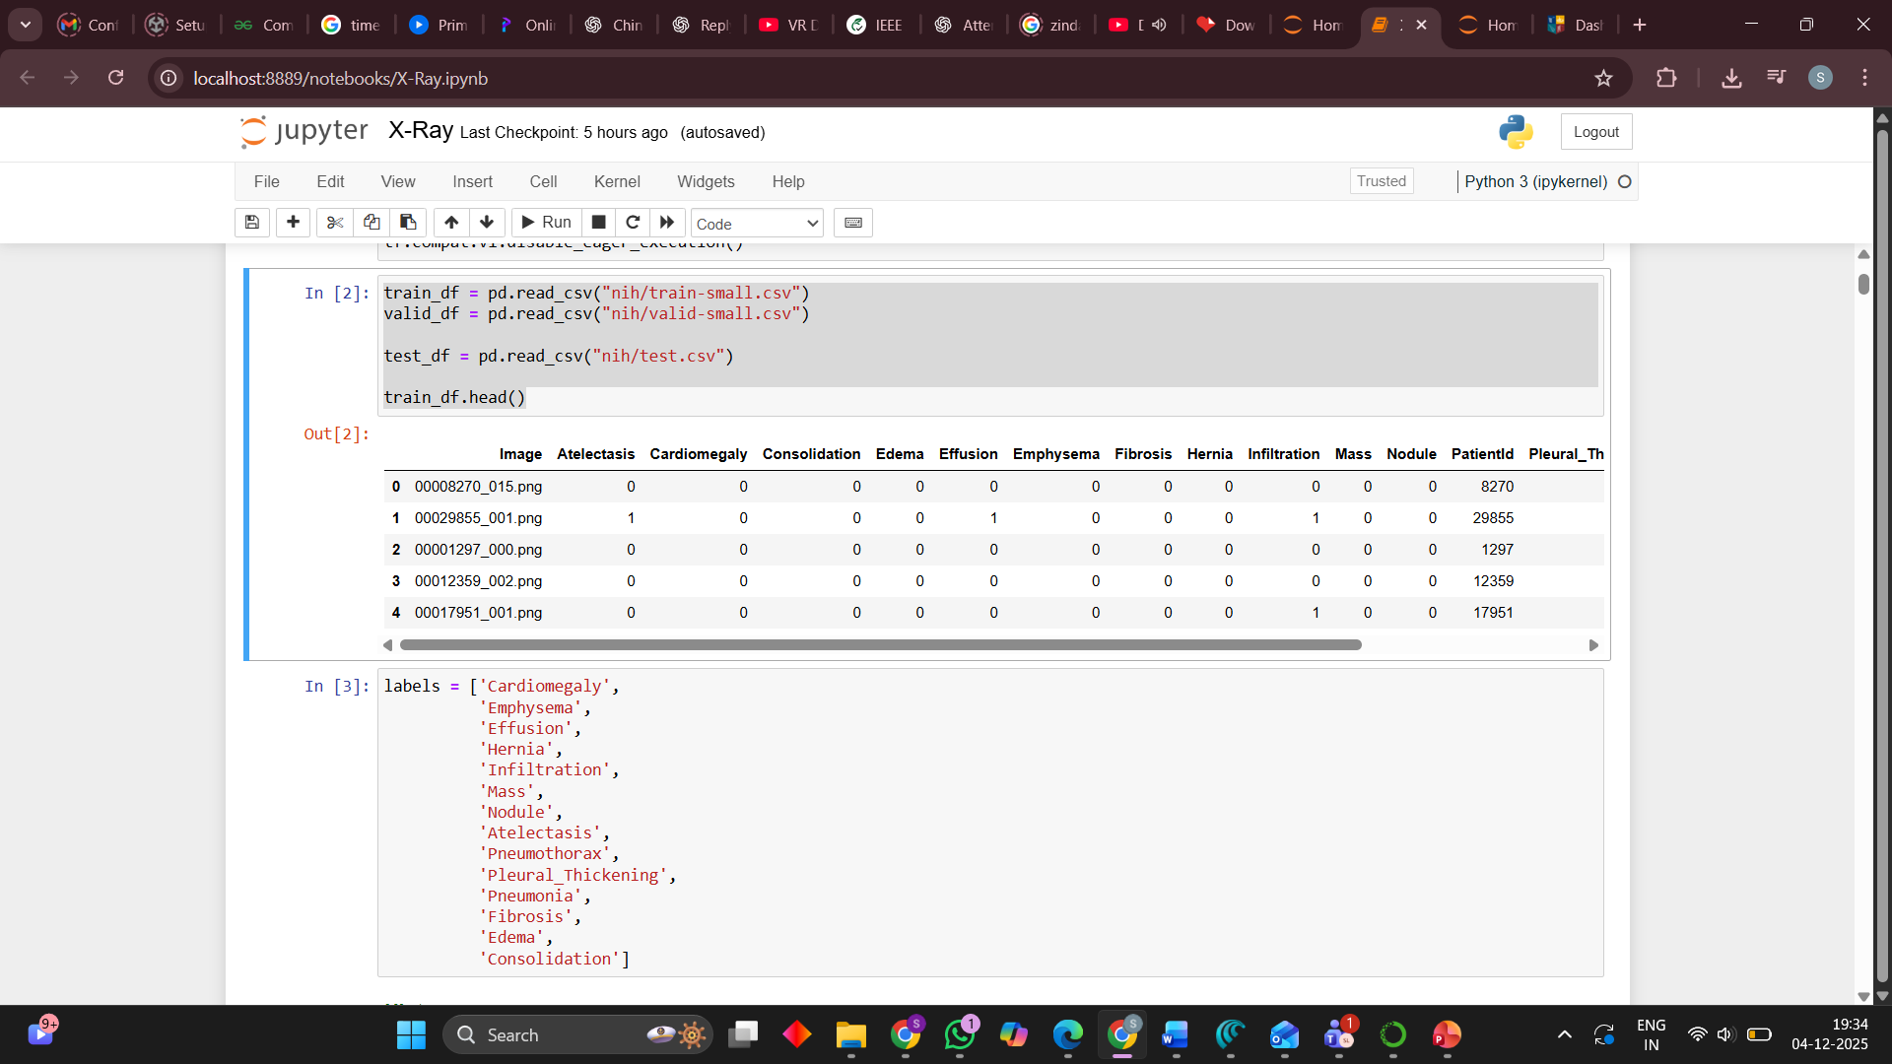
train_df.head() showing Image + a few label columns

Slide 5
Project Objective
Build a deep learning model to classify chest X‑rays into 14 diseases.
Use transfer learning under limited compute (train‑small only).
Achieve at least 75% test accuracy and evaluate with AUC/F1, not just accuracy.

Slide 6
Model Architecture (DenseNet‑121)
Backbone: DenseNet‑121 pre‑trained on ImageNet.
Remove original classification head.
Add:
Global average pooling.
Dense layer with 14 sigmoid outputs (one per disease).
Outputs a probability for each disease per image

Slide 7
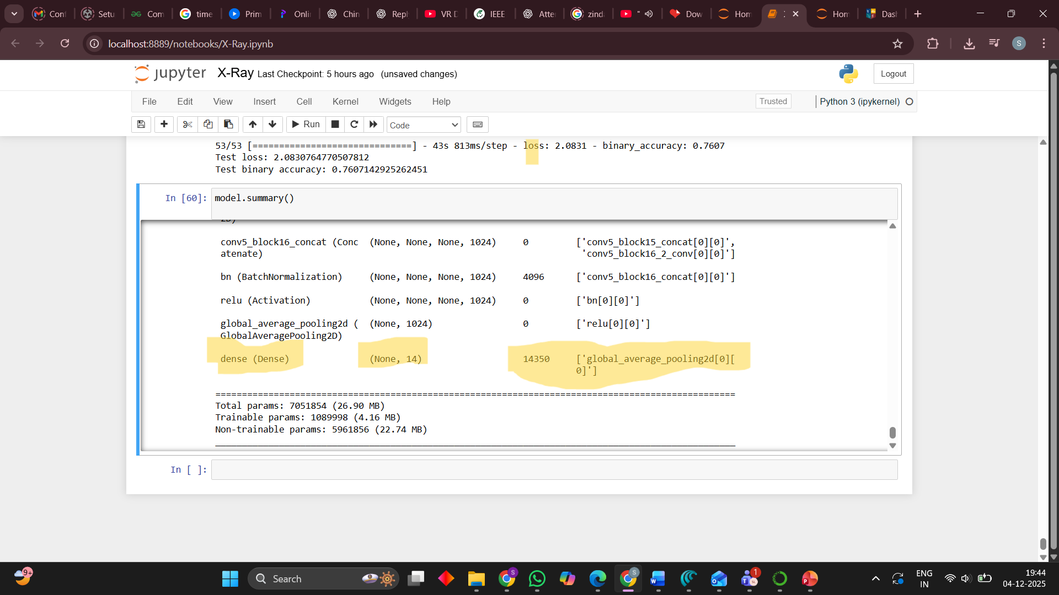
model.summary() showing DenseNet‑121 and final dense(14) layer.

Slide 8

Training Setup
Input: images resized to $320×320$, per‑image normalisation.
Loss: class‑weighted binary cross‑entropy (handles class imbalance).
Optimiser: Adam, small learning rate (${10}^{−3}$ → ${10}^{−5}$).
Early stopping on validation binary accuracy.

Slide 9
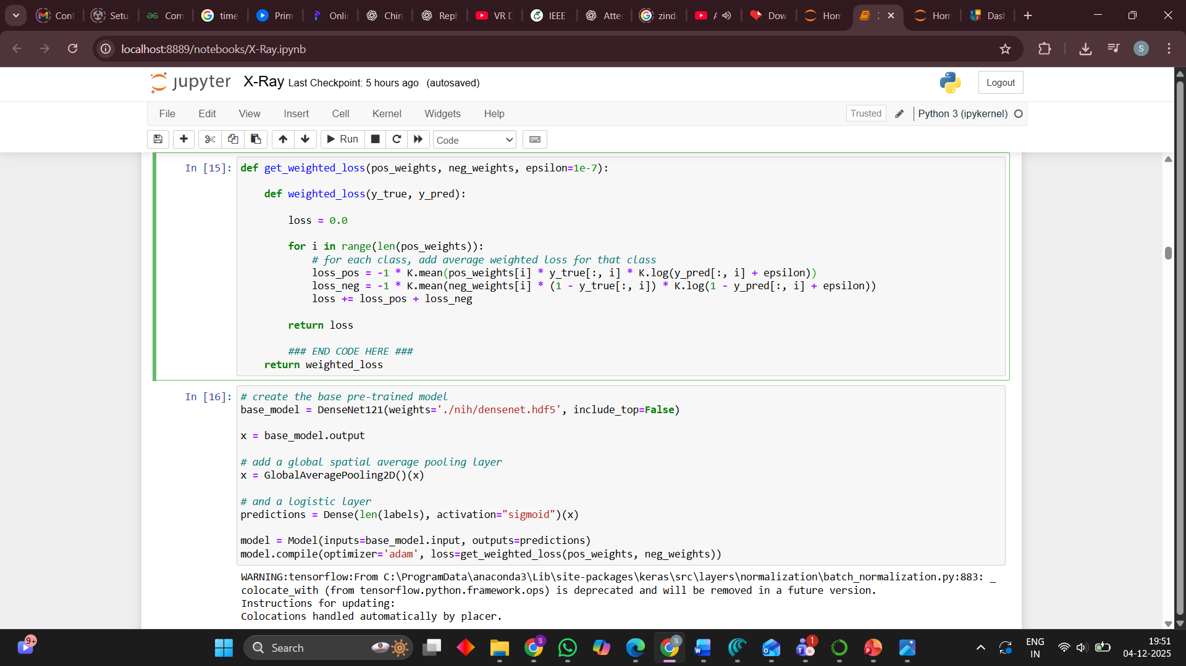
Code snippet where you compile the model (loss/optimizer/metrics).

Slide 10
Data Augmentation
Used to improve generalisation from train‑small:
Small rotations.
Width/height shifts.
Zoom.
Horizontal flips.
Makes model robust to patient positioning and imaging variation.

Slide 11
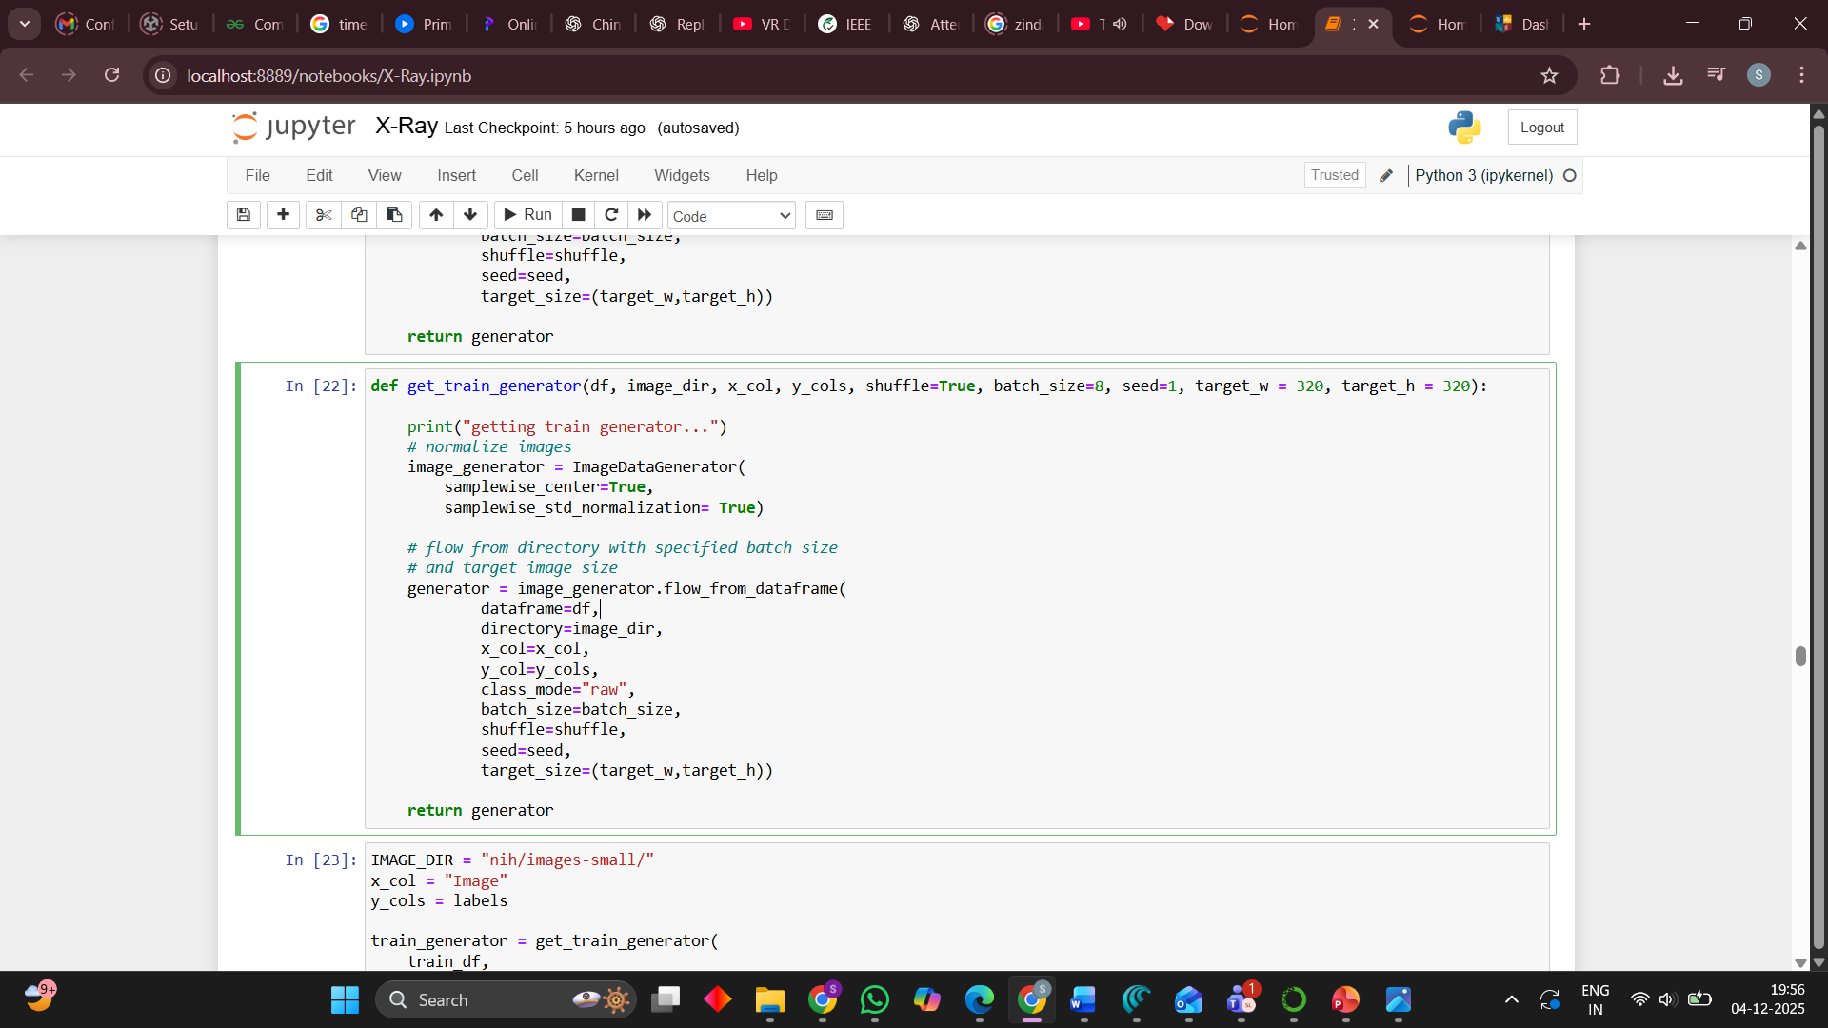
ImageDataGenerator in get_train_generator

Slide 12
Training Process & Improvements
Started from a simple setup: ~57% test accuracy.
Added augmentation + more epochs → ~66%.
Fixed steps per epoch + early stopping → ~73%.
Final tweak (batch size, more training) → ~76% test accuracy.

Slide 13
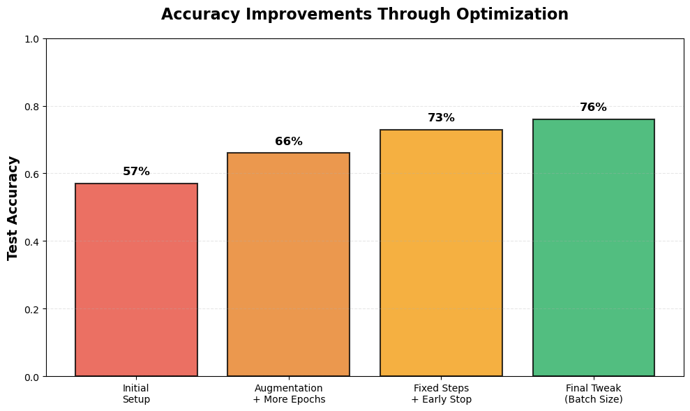
accuracy_improvements.png

Slide 14
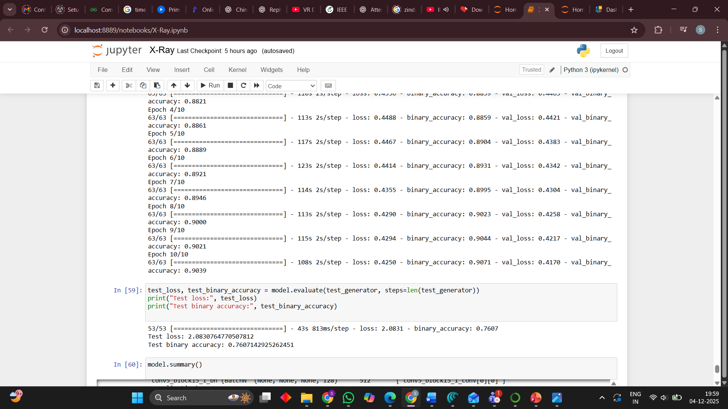
Training log snippet or accuracy/loss plot for final run

Slide 15
Evaluation Metrics
Accuracy alone is misleading for imbalanced multi‑label data.
Metrics used:
Binary accuracy.
Per‑class and macro AUC‑ROC.
Precision, recall, F1‑score.
Per‑class threshold tuning to maximise F1.

Slide 16
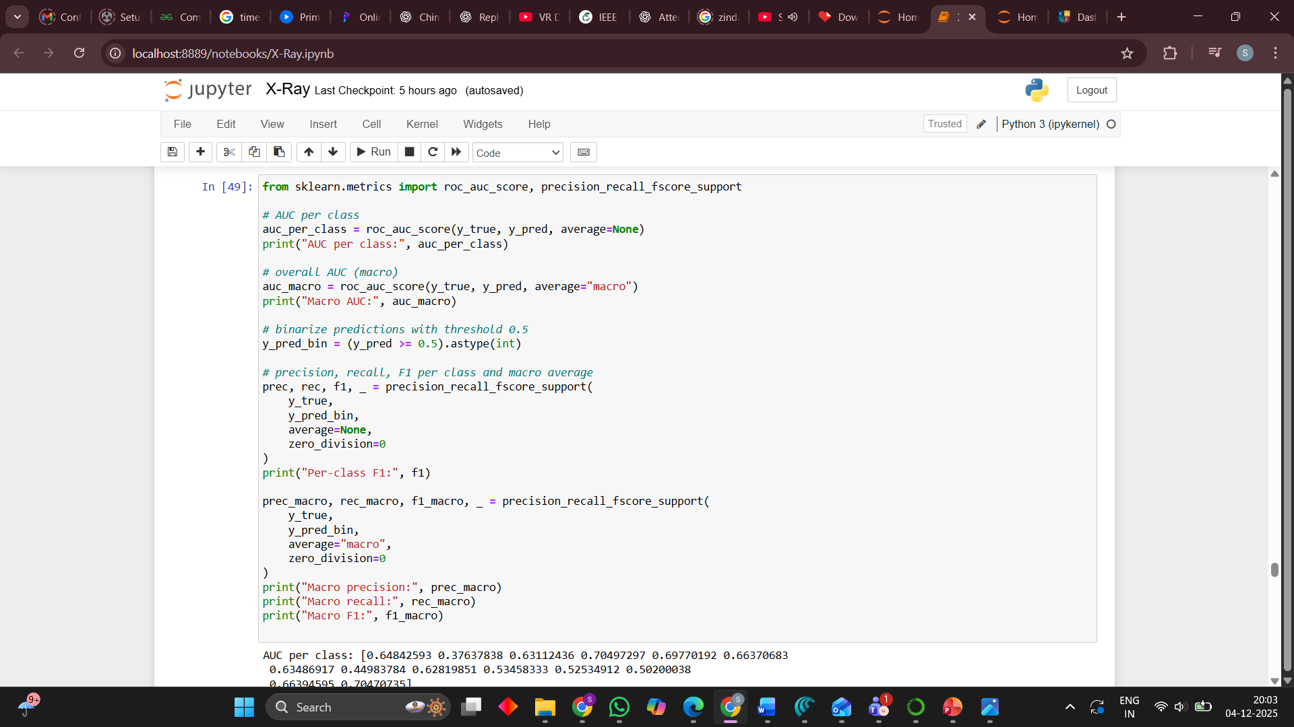
Code where you compute AUC and F1 with sklearn.

Slide 17
Quantitative Results
Final DenseNet‑121 model (train‑small):
Test binary accuracy: ≈ 76%.
Macro AUC: ≈ 0.60.
Macro F1 @ threshold 0.5: ≈ 0.24.
Macro F1 with per‑class thresholds: ≈ 0.29.
Some classes (e.g. Edema, Pneumothorax) reach AUC ≈ 0.70.

Slide 18
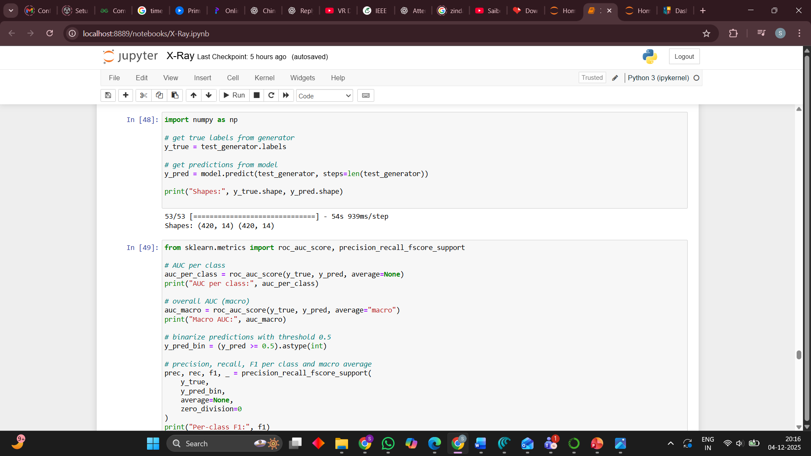
Final metric printout (macro AUC, macro F1, maybe AUC per class).

Slide 19
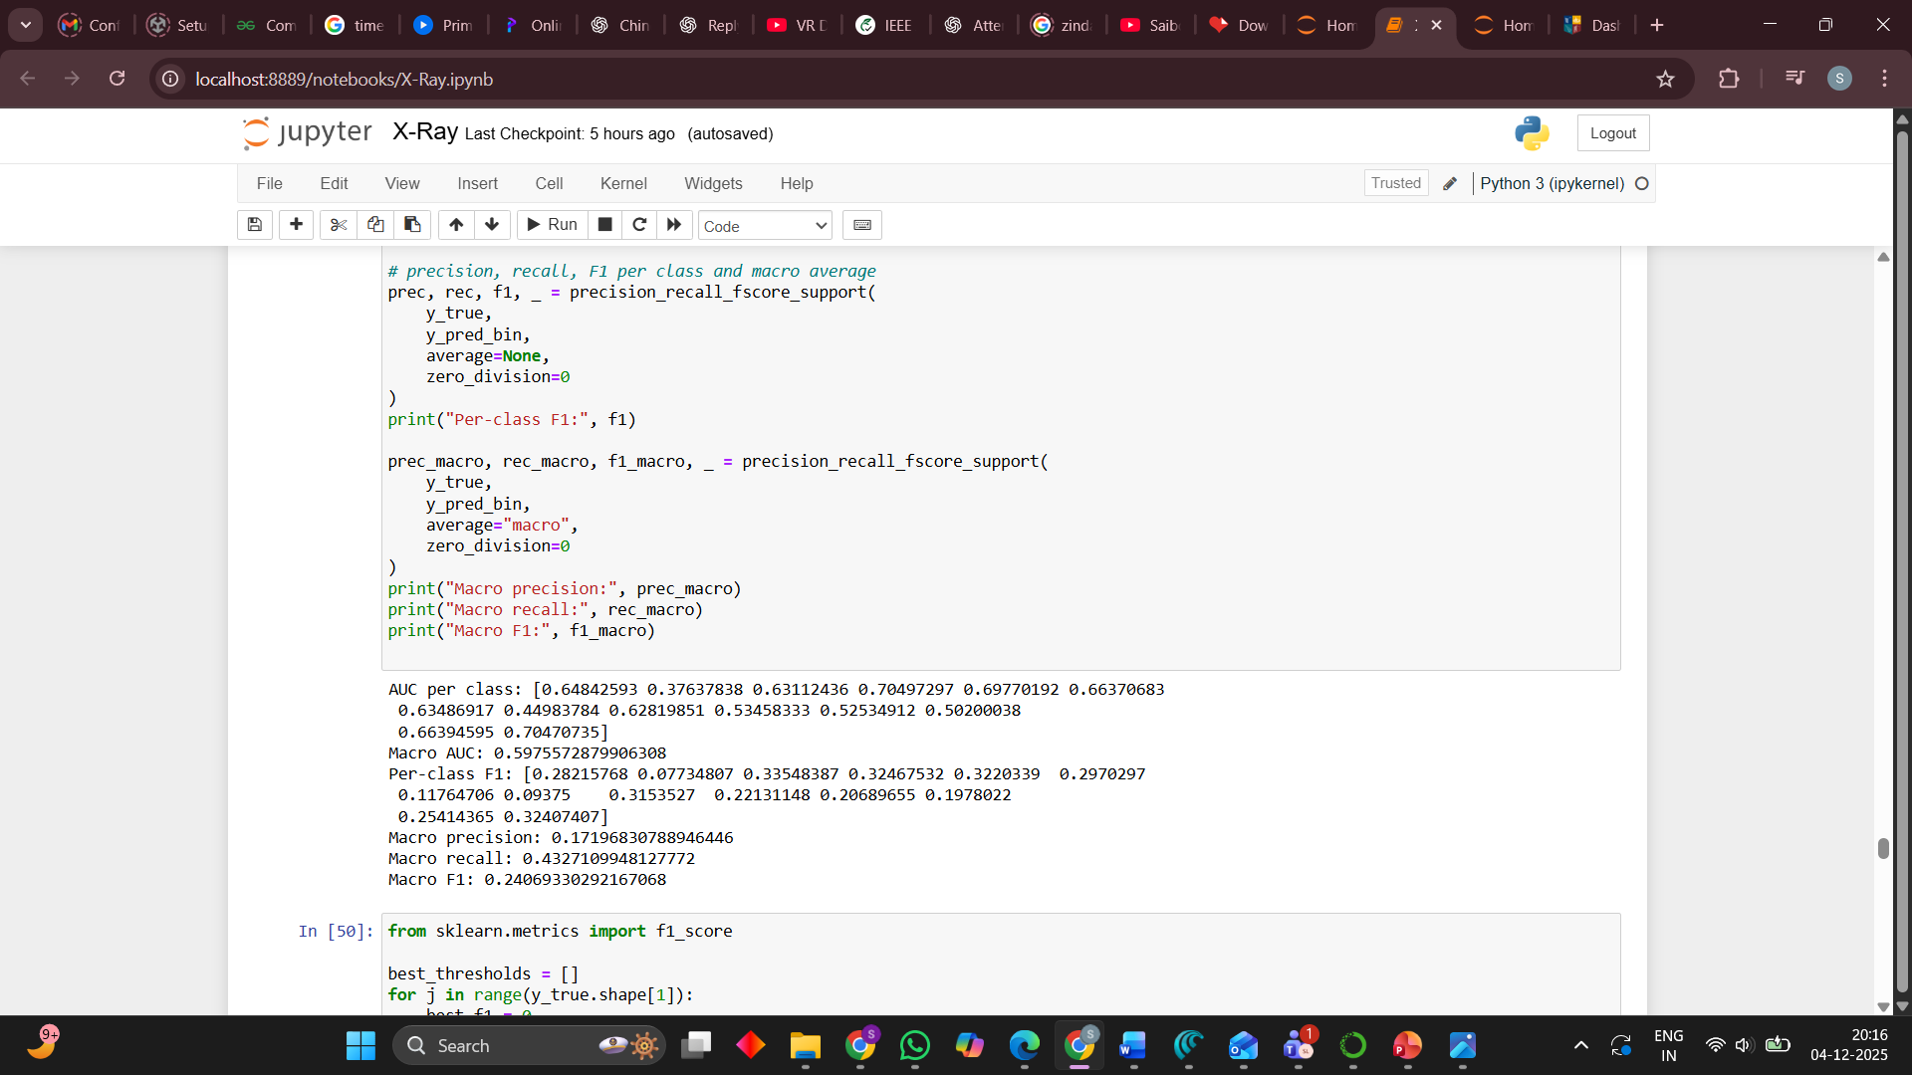
Final metric printout (macro AUC, macro F1, maybe AUC per class).

Slide 20
Model Explainability – Grad‑CAM
We used Grad‑CAM to visualise which regions of the X‑ray the model focuses on.
For each selected class (e.g. Cardiomegaly, Mass, Pneumothorax, Edema), we overlay a heatmap on the original image.
In many cases, the highlighted areas correspond to the expected anatomical regions (e.g. lung fields, heart area, suspicious mass).

Slide 21
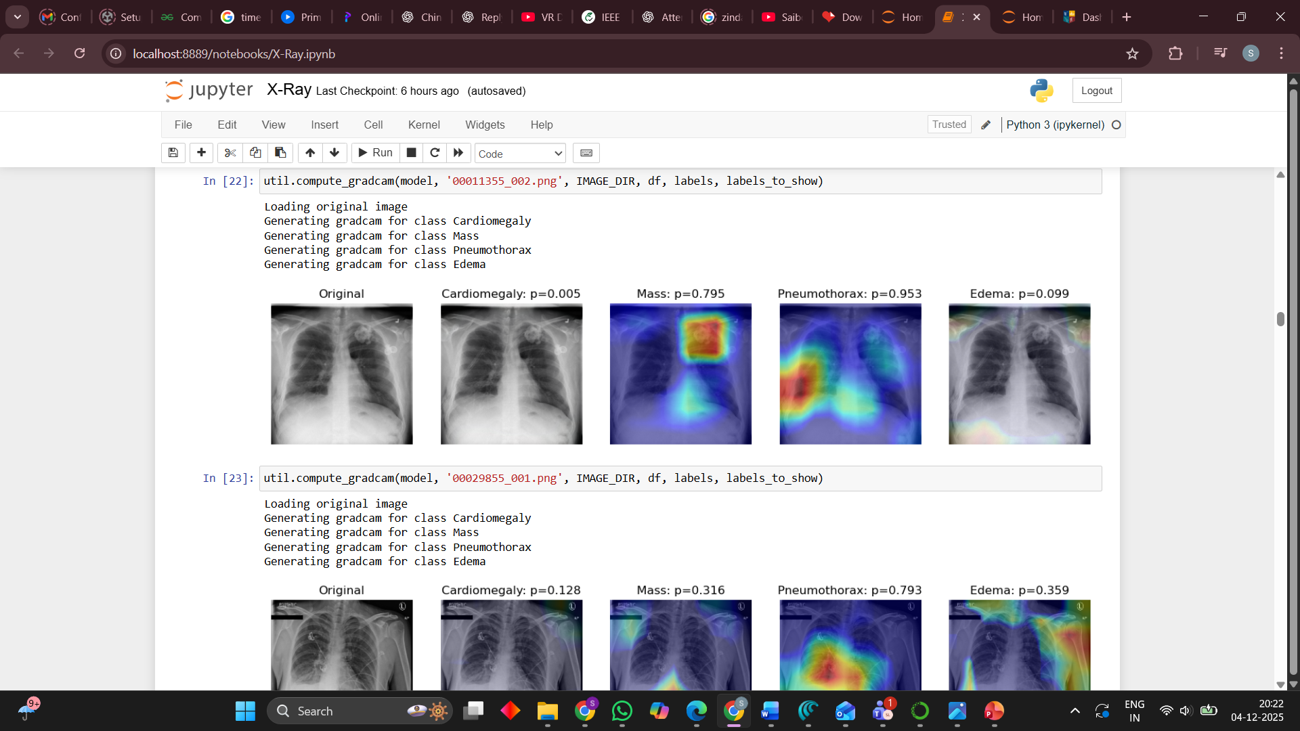
original X‑ray plus several Grad‑CAM heatmaps

Slide 22
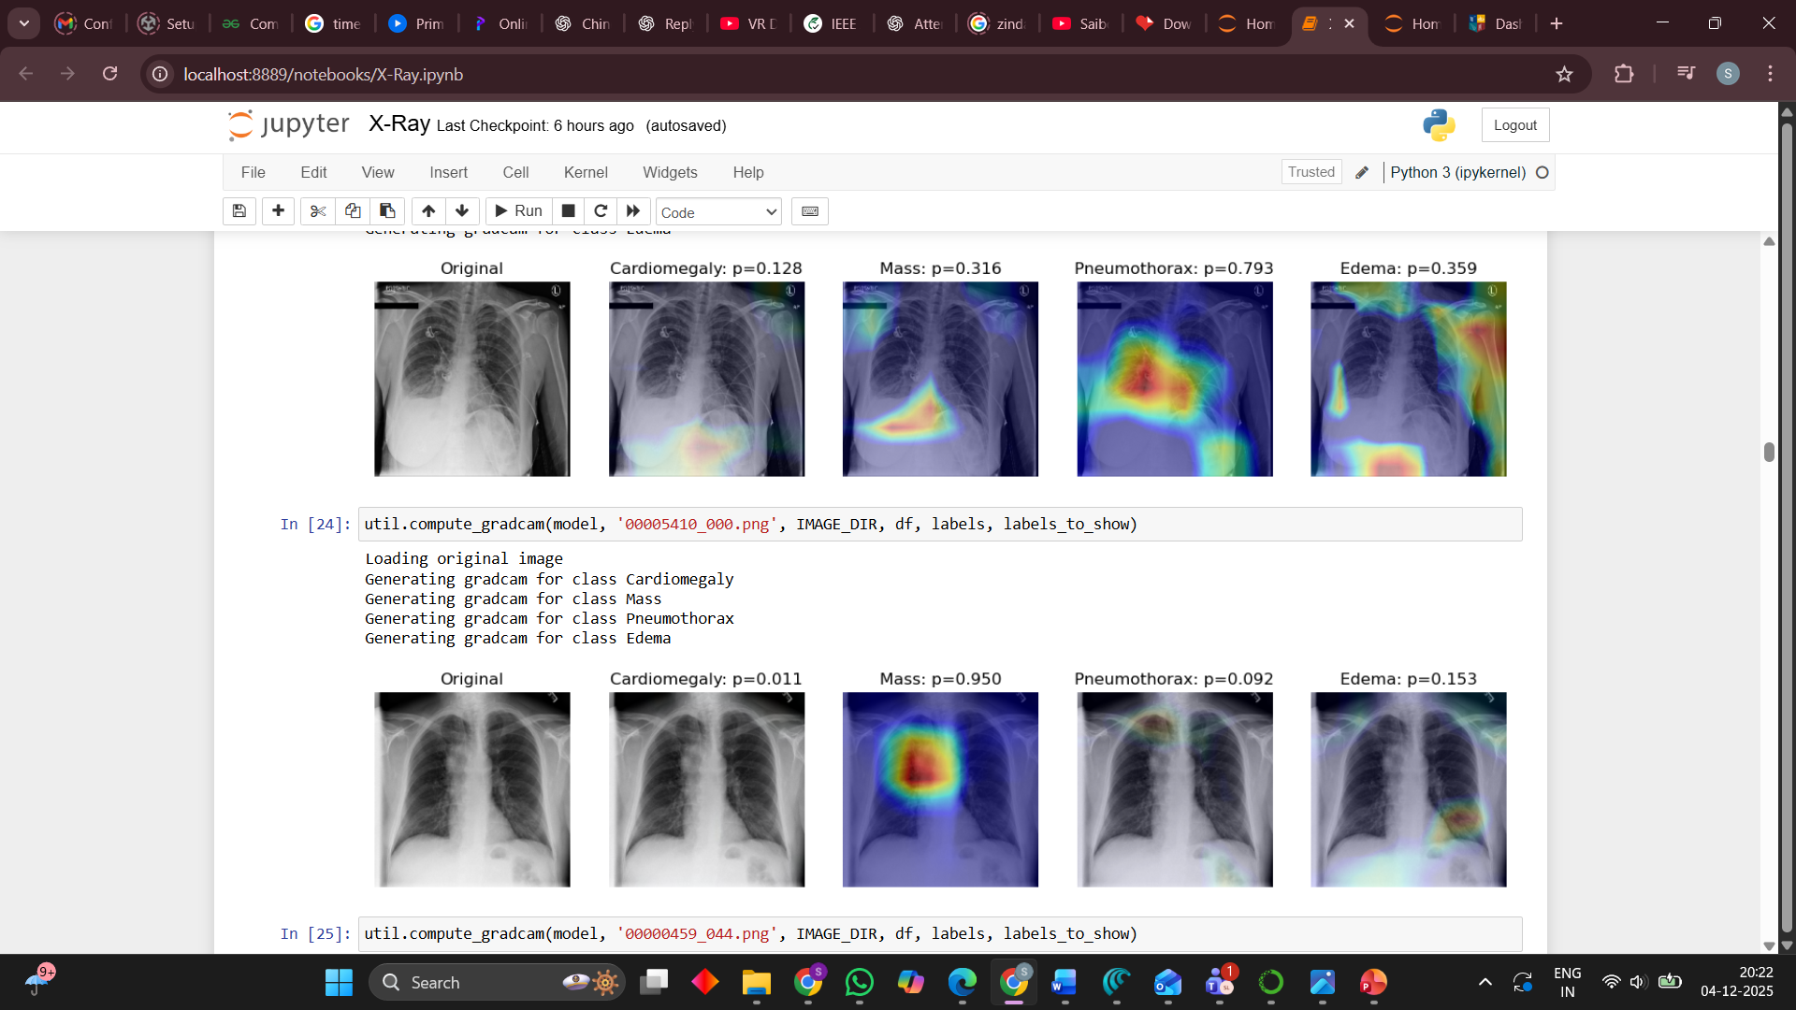
original X‑ray plus several Grad‑CAM heatmaps

Slide 23
Discussion & Limitations
Strengths:
Uses a strong CNN (DenseNet‑121) with transfer learning.
Handles multi‑label outputs (14 pathologies).
Class‑weighted loss + augmentation + early stopping.
Limitations:
Trained only on train‑small, not full 112k images.
Limited hyper‑parameter search, no ensembles.
Results not directly comparable to full‑dataset state‑of‑the‑art.

Slide 24
Conclusion
Achieved ~76% accuracy with reasonable AUC/F1 under resource constraints.
Showed importance of:
Data augmentation and training duration.
Class weighting and threshold tuning.

